Slide 1
Key Card access to Stone 218/219
Email name/NetID/course number to support@cfc.umt.edu
Enter through Stone 219; access Stone 218 through door between the rooms.
Join MAGIP list-serve https://www.magip.org
Resources -> E-mail List-Serve
Syllabus Quiz on Tuesday
https://umtgis.github.io/apps/syllabus/

Slide 2
Coordinate Systems,
Map Projections, Scale
and GDBs
A Concise Review,
Without All the Fat!

Slide 3
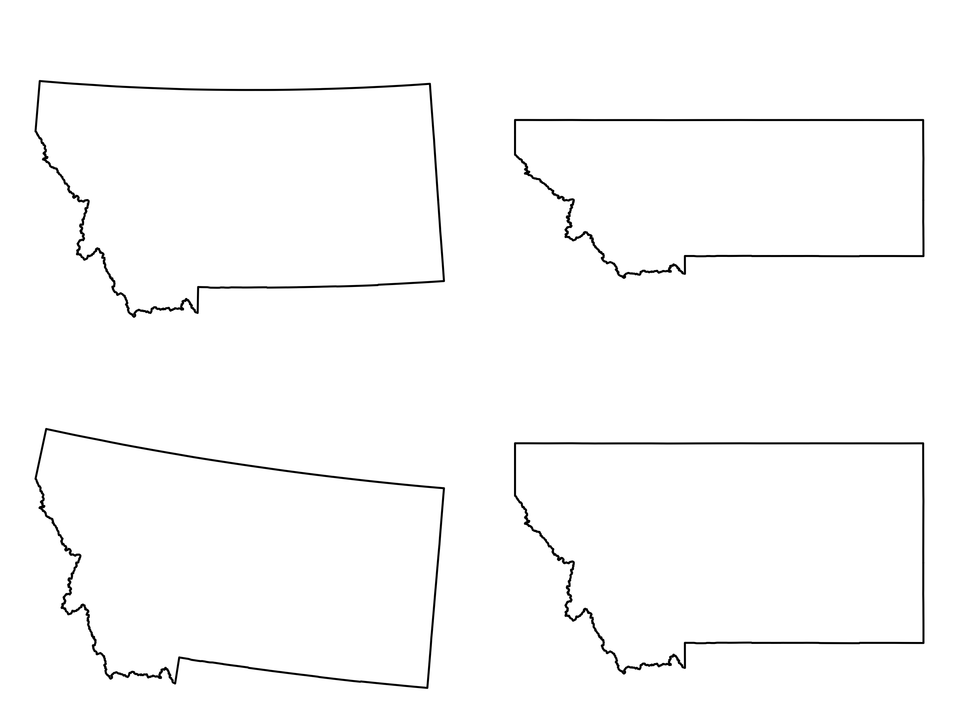

Slide 4
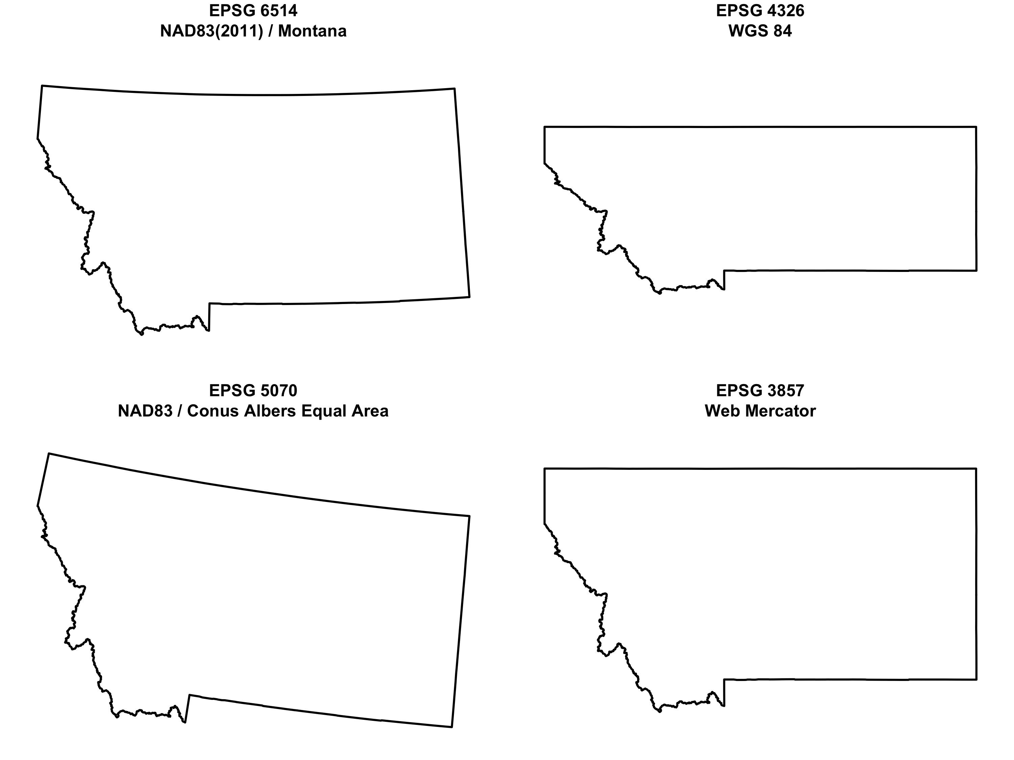

Slide 5
When choosing map projections,
seek balance
Representation of Phenomena
Distortion
Accuracy
Aesthetics
Audience Expectations

Slide 6
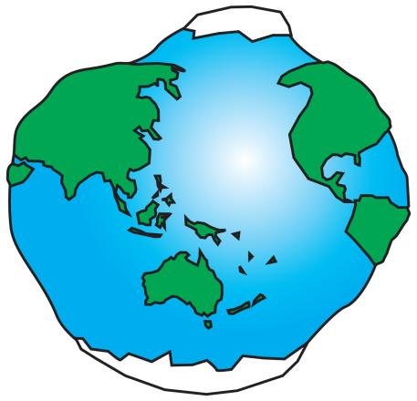
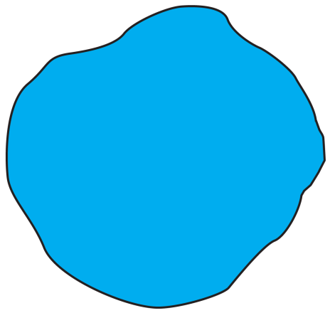
Spheroid Ellipsoid Geoid
Tie Points

Slide 7
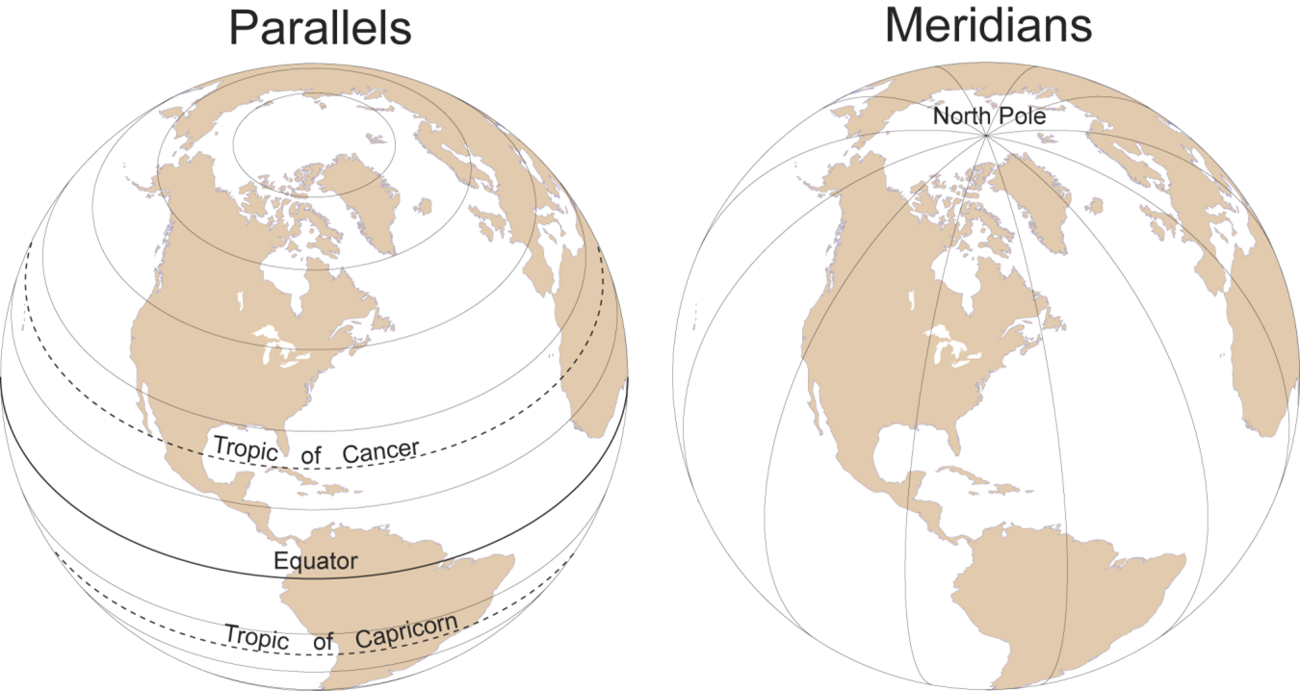
Coordinate Systems
Longitude
Latitude

Slide 8
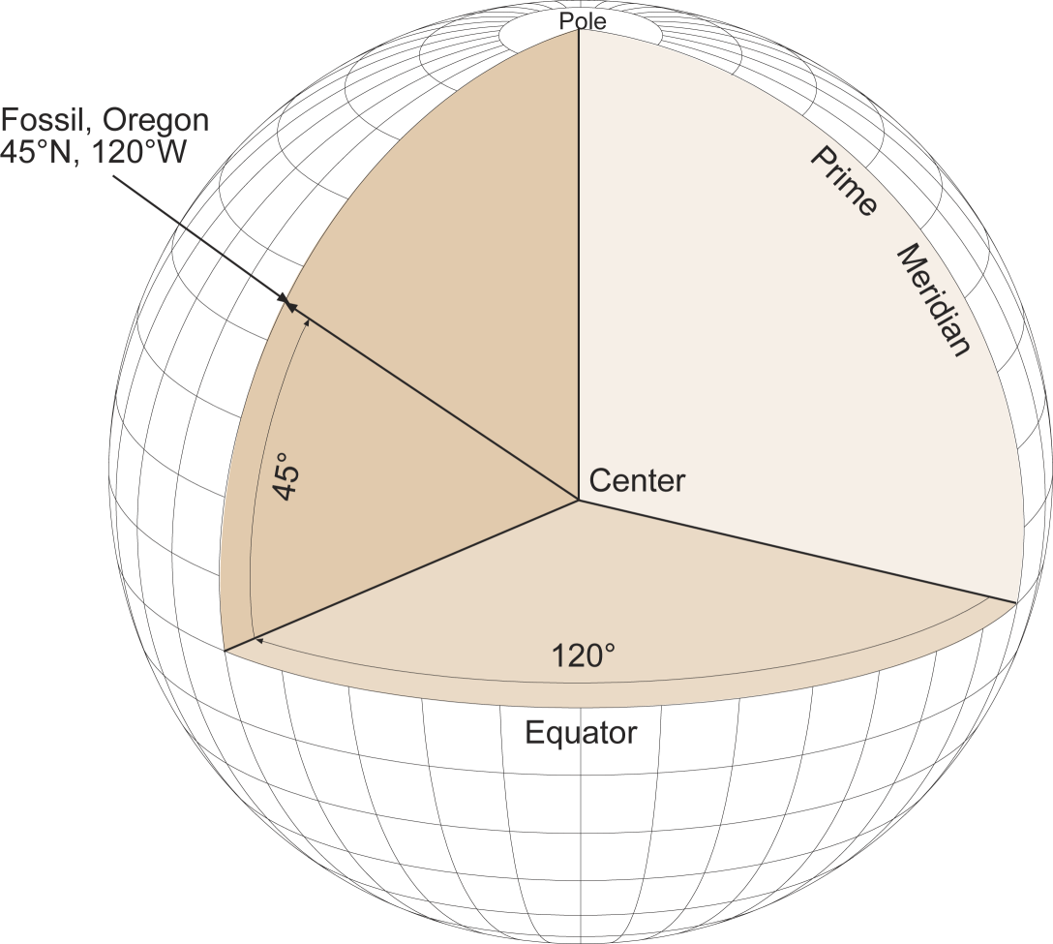
Coordinate Systems
AKA: “The Graticule”
Is 45°N positive or negative?
Is 120°W positive or negative?
45, -120

Slide 9
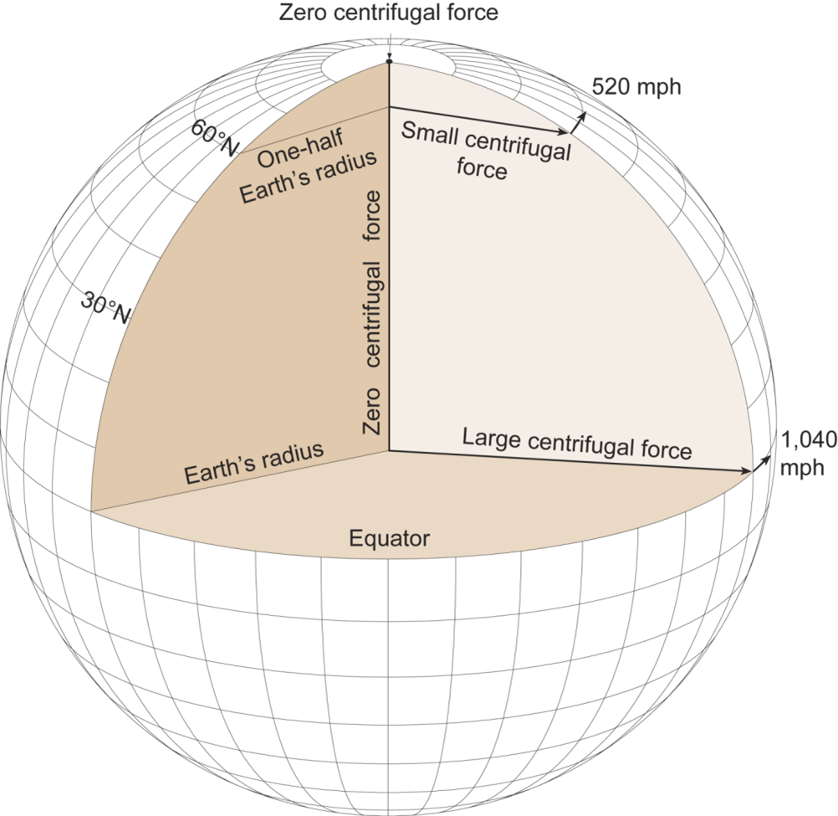
Ellipsoid

Slide 10
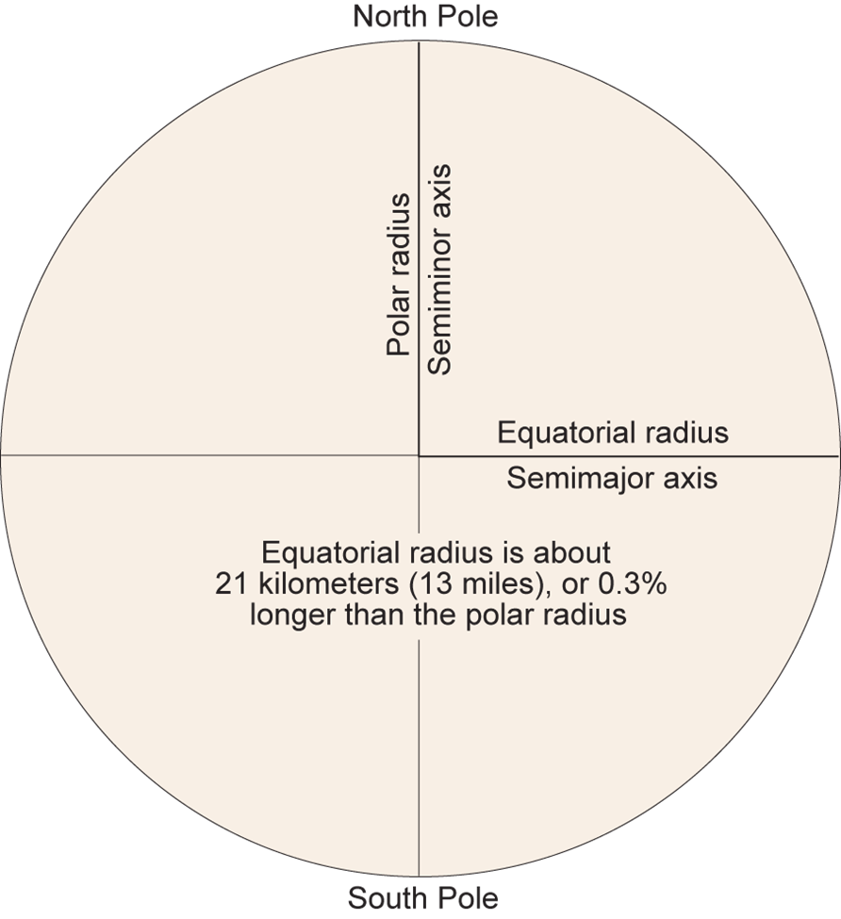
Ellipsoid

Slide 11
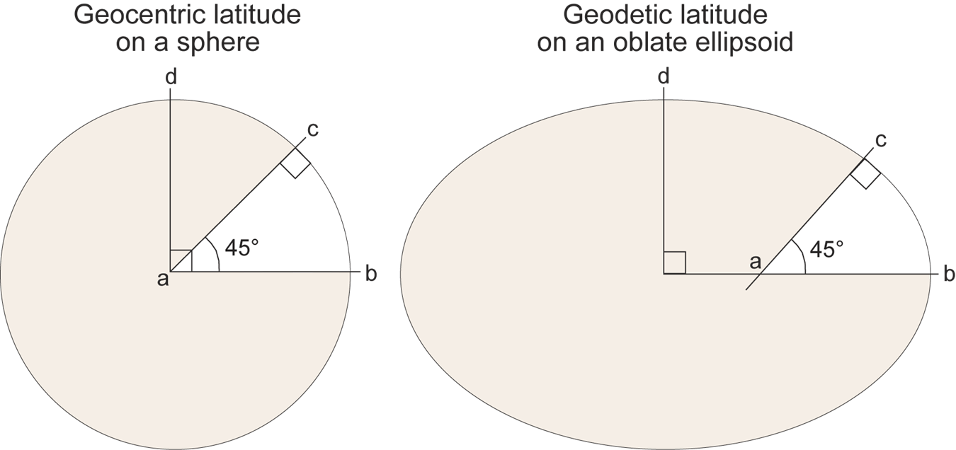
Ellipsoid

Slide 12
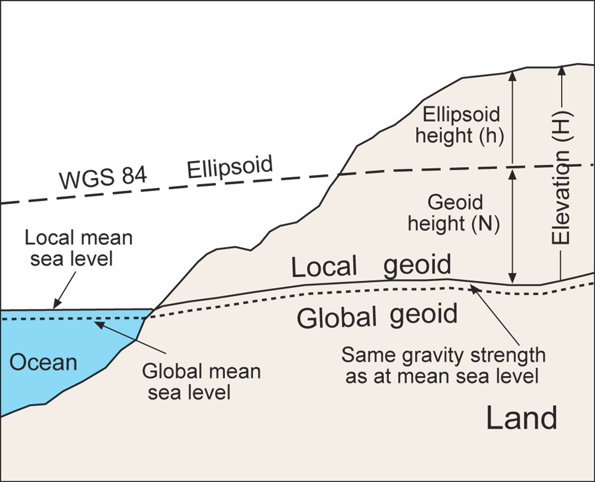
Geoid

Slide 13
What the Heck is a Datum?
Ellipsoid
+
Geoid
+
(Coordinates)
Tie Points
=
Datum
Also called:
Geographic Coordinate System
Geographic Coordinate System

Slide 14
So… Where’s the Beef?
The ellipsoid and geoid only matter if you are building\customizing reference systems…...
In common use, just know that they are incorporated within the datum (GCS):
NAD 27 uses the Clarke 1866 Ellipsoid
NAD 83 uses the GRS 1980 Ellipsoid
WGS 84 uses the EGM 1996 Ellipsoid
Etc….
TAKE HOME: These 3 Datums are what you will use 90% of the time. If you need another, look it up! https://epsg.io

Slide 15
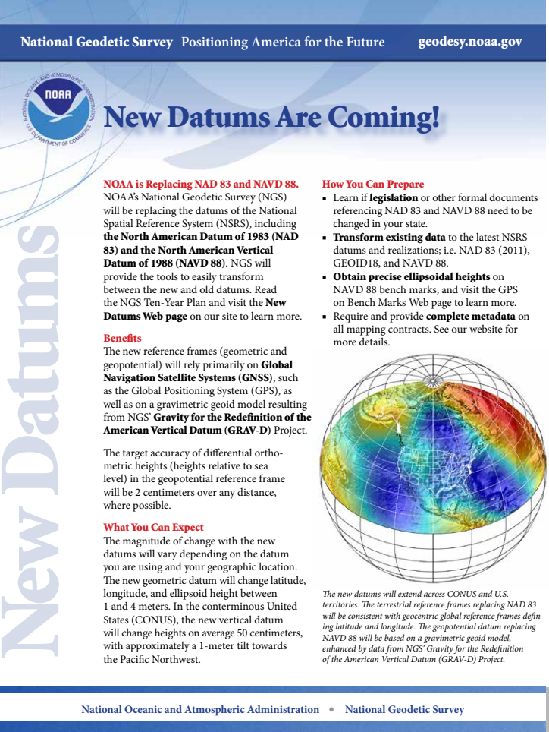
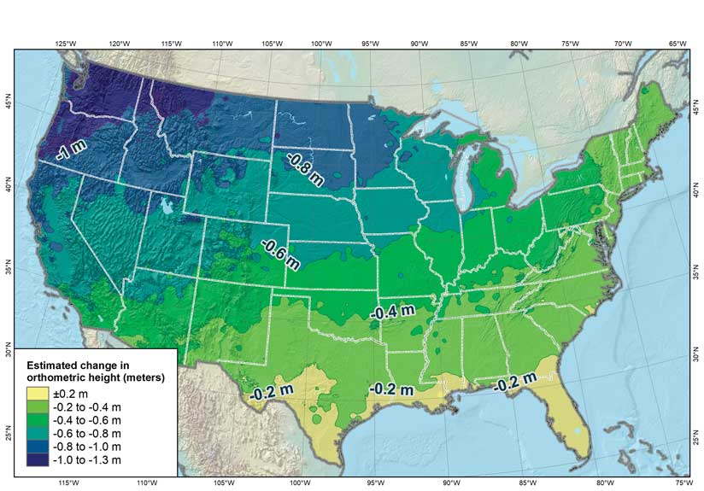
NOAA
ESRI

Slide 16
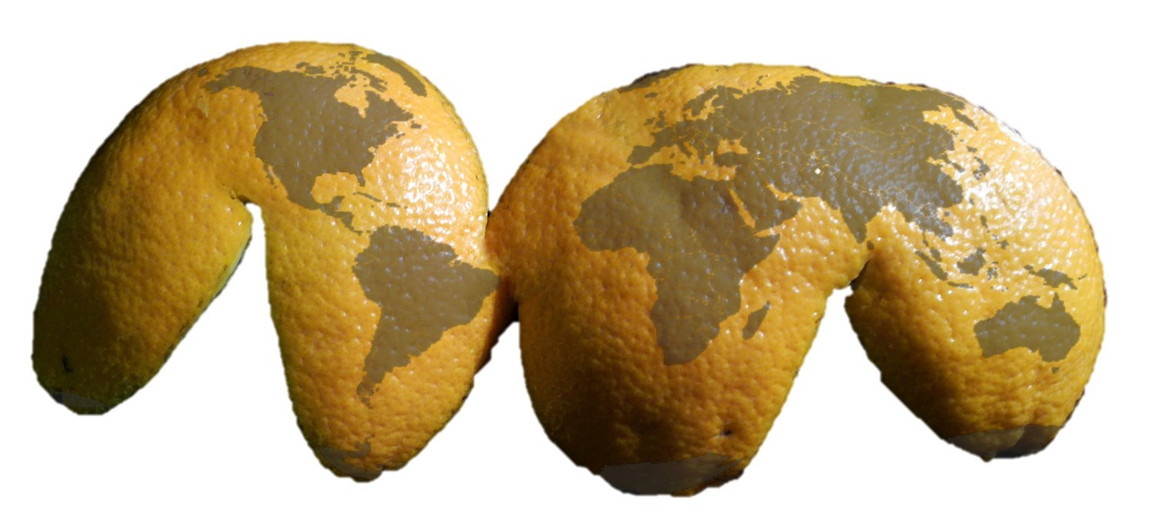
Projections – Distilled
Shearing:
stretching the skin in one or more directions
Tearing:
causing the skin to separate
Compressing:
forcing the skin to bunch up and condense

Slide 17
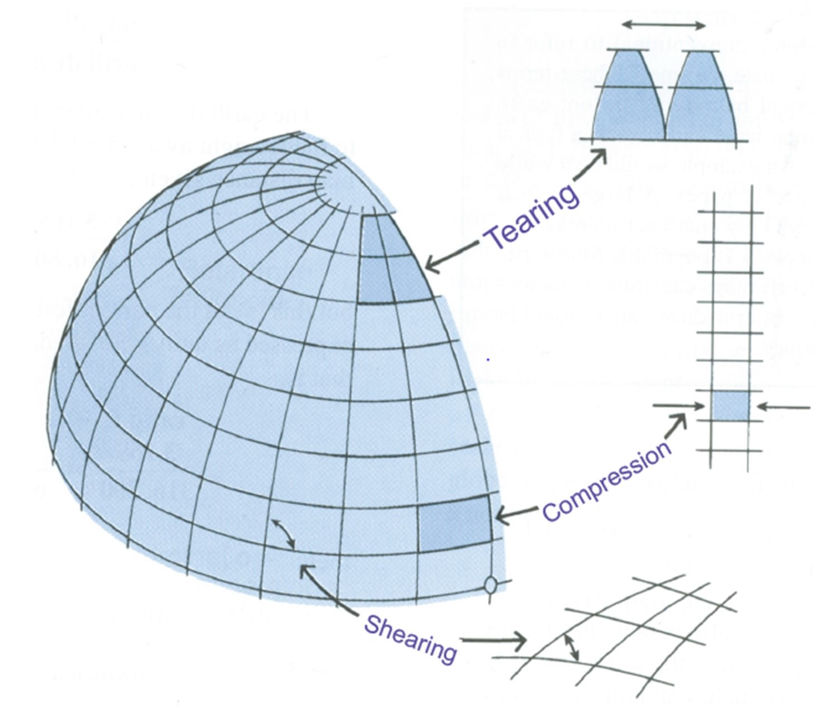

Slide 18
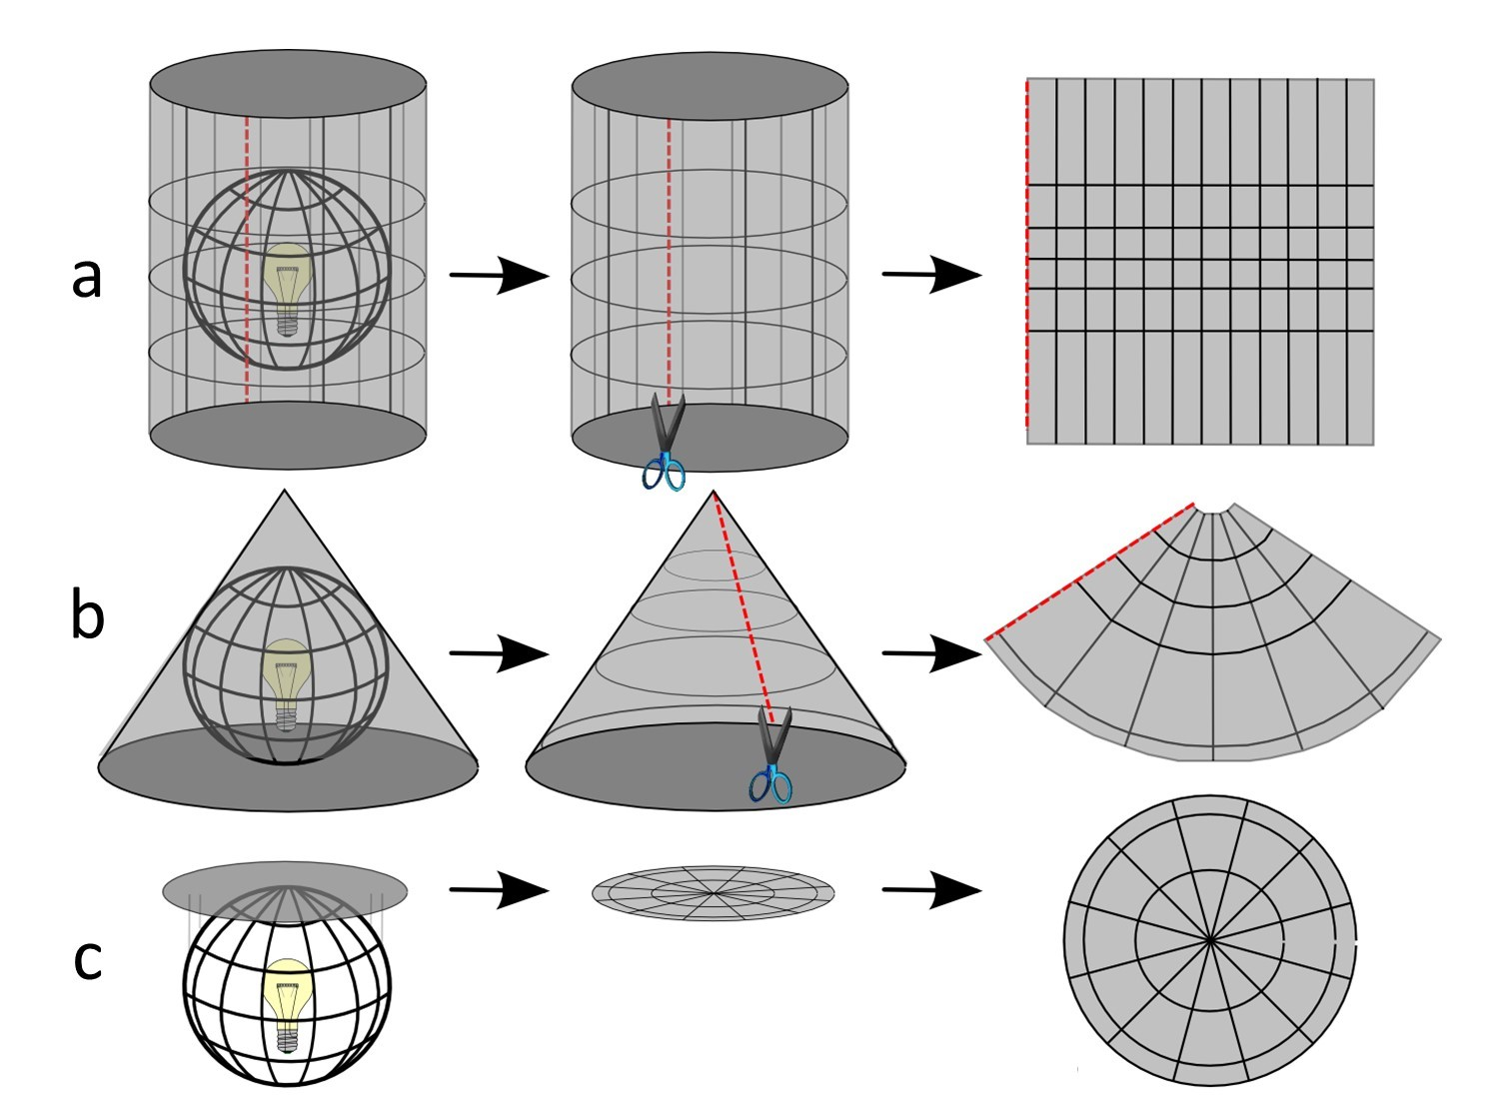
Cylindrical
Conical
Planar

Slide 19
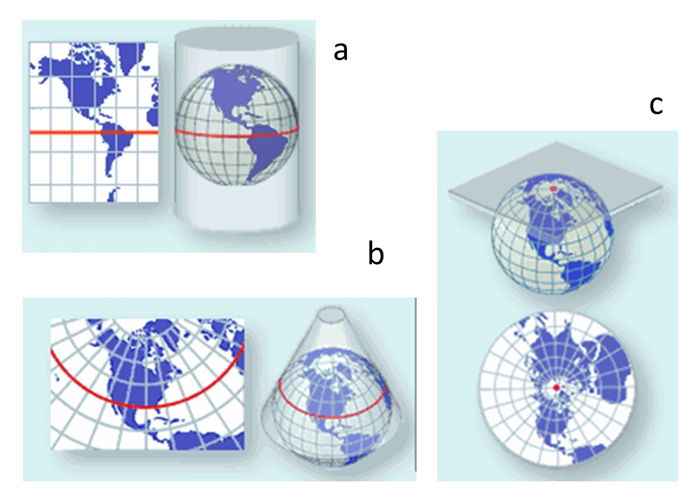
Cylindrical
Planar
Conical

Slide 20
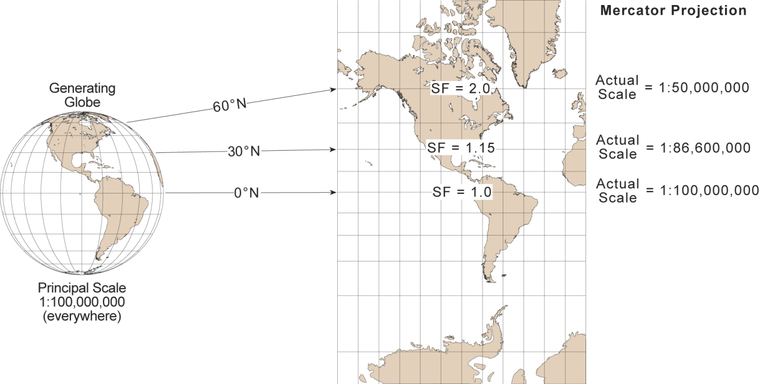
Projections

Slide 21
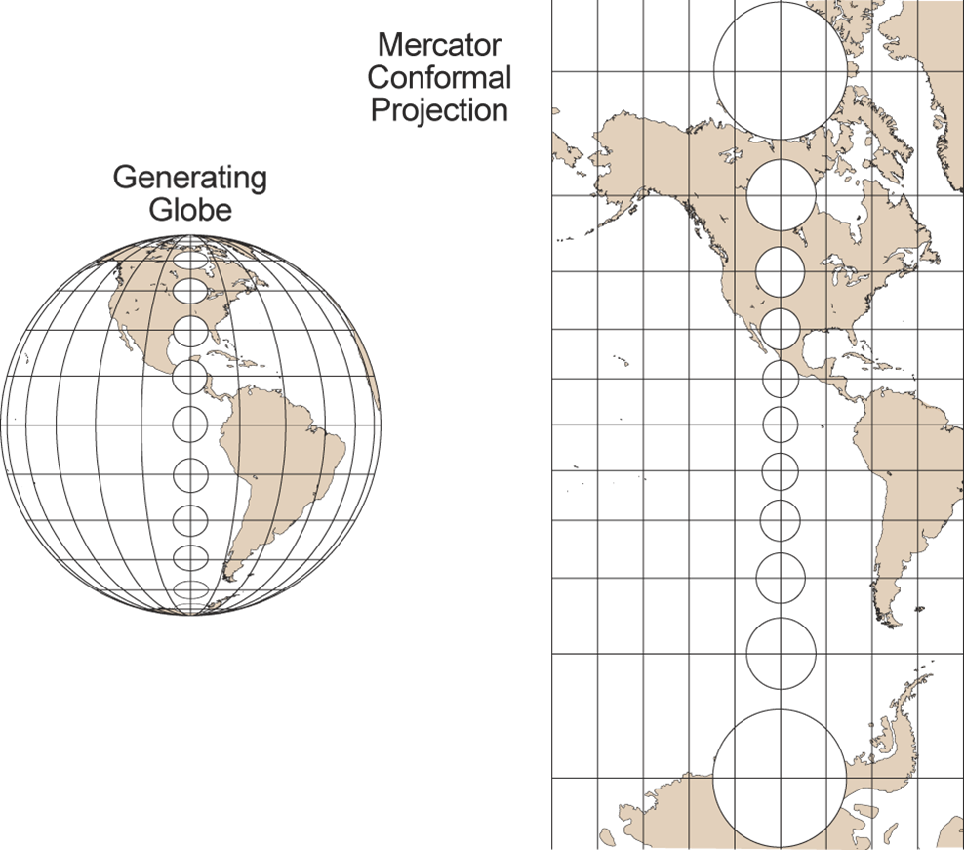
Projections

Slide 22
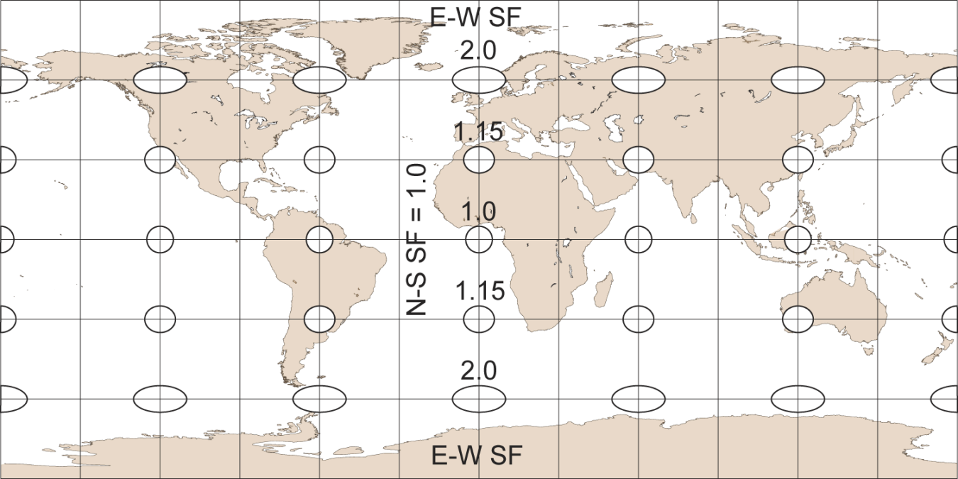
Projections

Slide 23
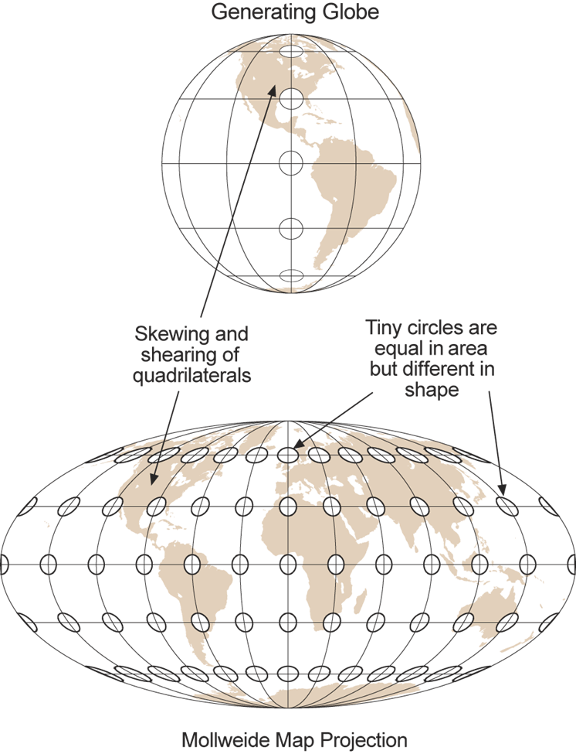
Projections
All Projections are Distortions! All we can do is compromise what gets distorted.

Slide 24
Projections – Distilled
To Choose a Projection Ask…
What is the nature of the phenomena to be analyzed?
In other words, do you want to compare:
Area,
Distance,
Shape,
or
Direction

Slide 25
Projections – You Have to Choose One
Azimuthal — Direction from a given central point to any other point is shown correctly. Use to evaluate the direction phenomena move from a location.
Conformal — Angles and shapes at each point are preserved. Use to compare the shape of phenomena in relation to one another.
Equal-area — All areas have the same relative area as the corresponding part on the Earth. Use to compare the area of phenomena in relation to one another.
Equidistant — Shows true distances from a center point or along a special set of lines. Use to measure the distance between phenomena, either spreading from a point or along a route.

Slide 26
Projections
https://map-projections.net/

Slide 27
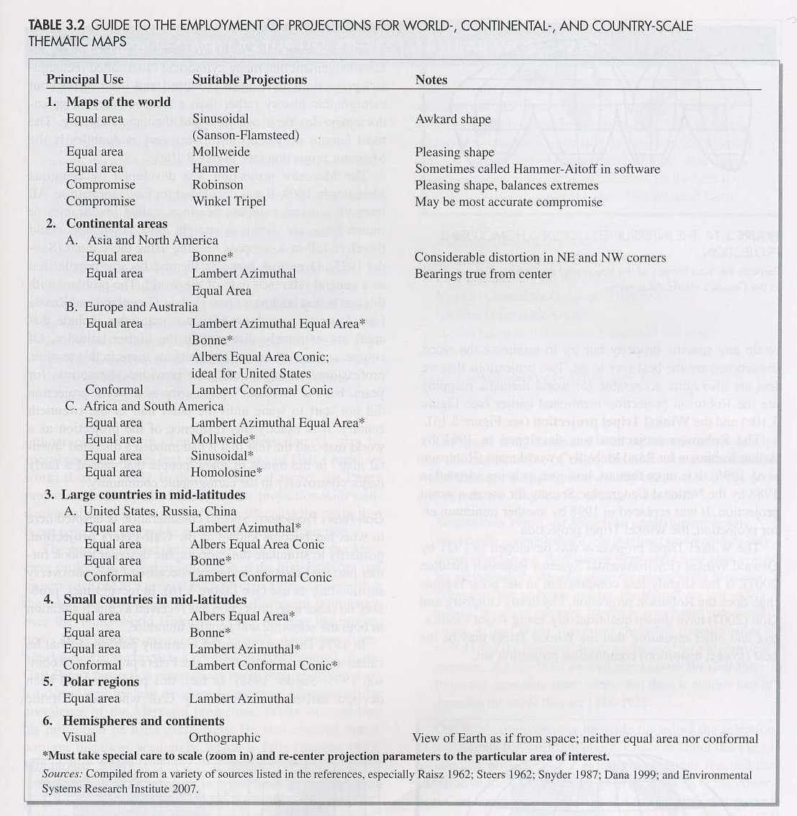
Projections – Choose Map Extent

Slide 28
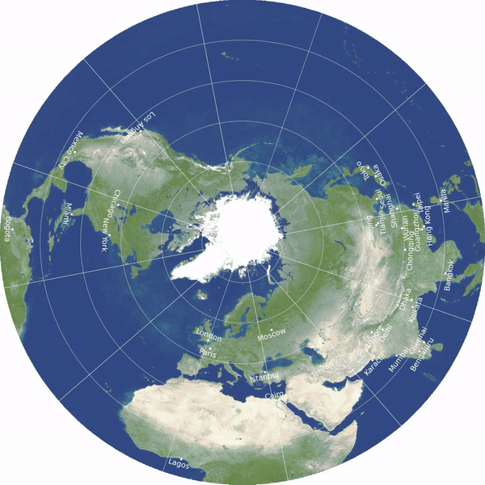
Double sided disk by J. Richard Gott, Robert Vanderbei and David Goldberg

Slide 29
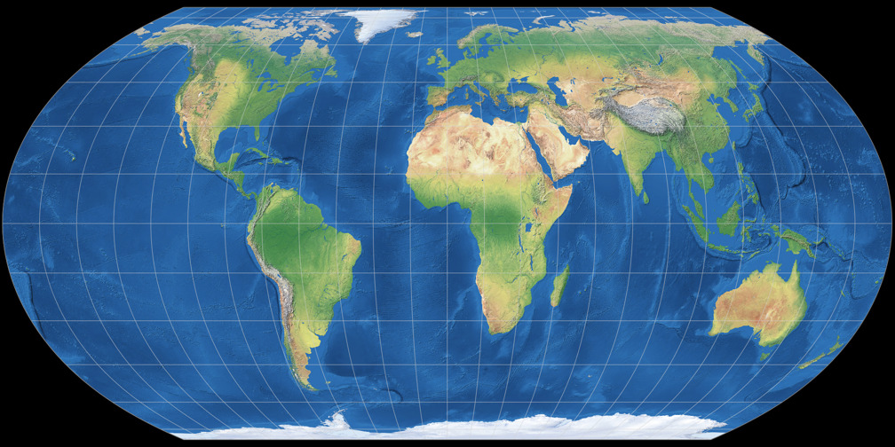
Equal Earth projection by Bojan Savric, Tom Patterson, Bernhard Jenny (2018)

Slide 30
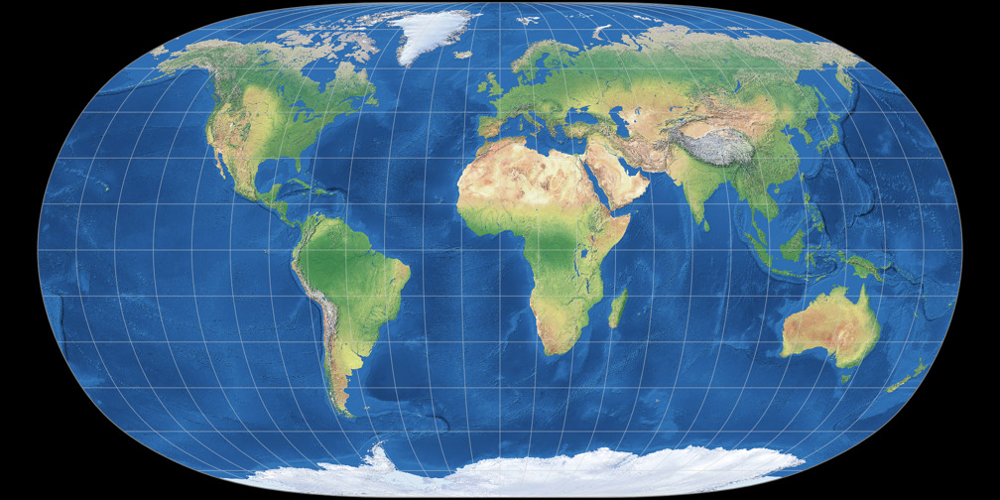
Natural Earth II projection by Tom Patterson, Bojan Savric, Bernhard Jenny (2015)

Slide 31
https://map-projections.net/singleview.php

Slide 32
Projections – In 3 East Steps
Determine if your data is best analyzed by area, distance, shape, or direction.
Choose the best projection compromise for your data type.
Select the best projection for the geographic extent being mapped.
TAKE HOME: The Equal-area projection is by far the most popular for thematic mapping.

Slide 33
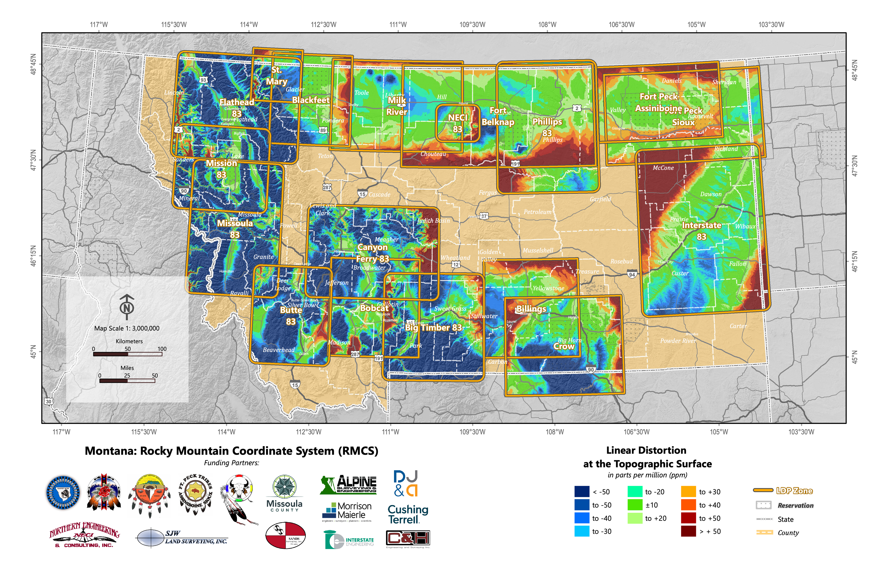
https://www.marls.com/resources/rmtcrs-information/

Slide 34
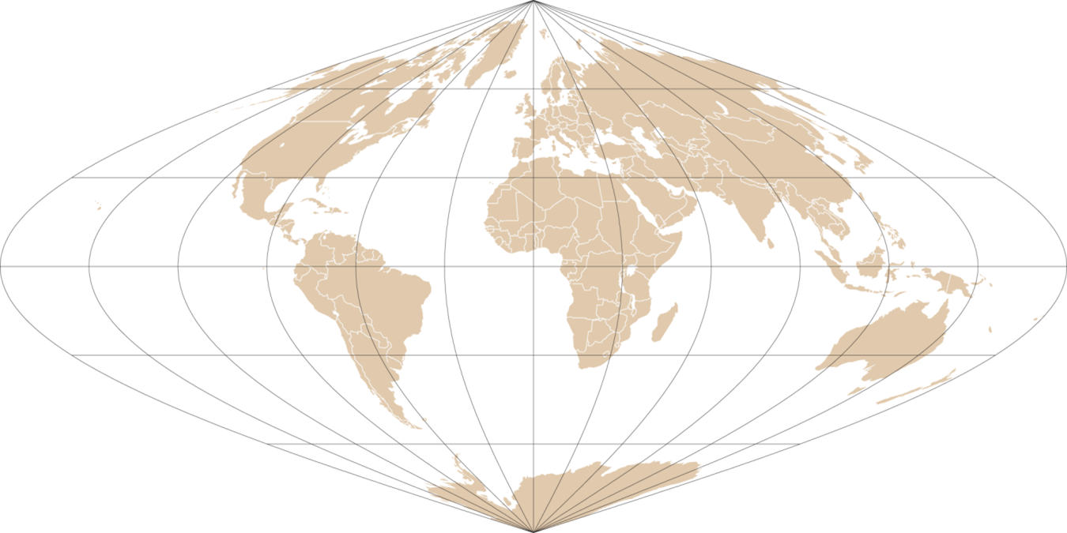
Scale
Scale—The relationship between a distance on a map and the corresponding distance on the Earth.
Three Types
Representative Fraction – 1:100,000
Verbal Scale – 1 inch to the Mile
Graphic Scale – Scale Bar

Slide 35
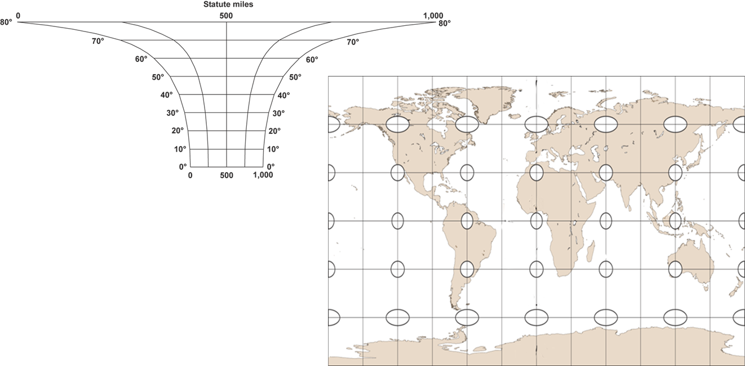
Scale
Scale varies across Small Scale Maps of the World
This would be the correct scale on a Mercator World Map.

Slide 36
Scale
Large Scale
1:25,000
IT’s
1:250,000
RELATIVE
1:25,000,000
Small Scale

Slide 37
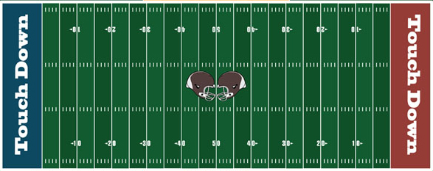
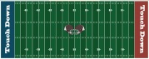
Scale
Large Scale
Smaller Number
Larger Features
Smaller Area
11” x 17”
1:1,800
Small Scale
Larger Number
Smaller Features
Larger Area
11” x 17”
1:72,000

Slide 38
Scale
TAKE HOME: Scale is not equal across all areas of a small scale projection. On world maps, a static scale bar is virtually useless. A Conic Projection is a good compromise for true scale when mapping mid-latitude continents.

Slide 39
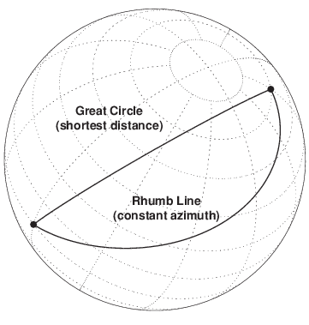
Great Circles Vs Rhumb Lines

Slide 40
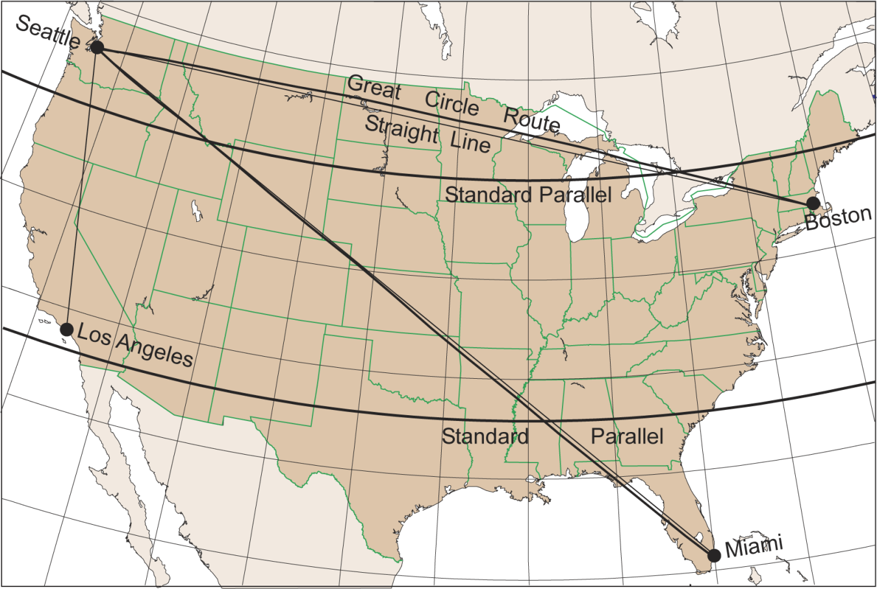
Great Circles Vs Rhumb Lines

Slide 41
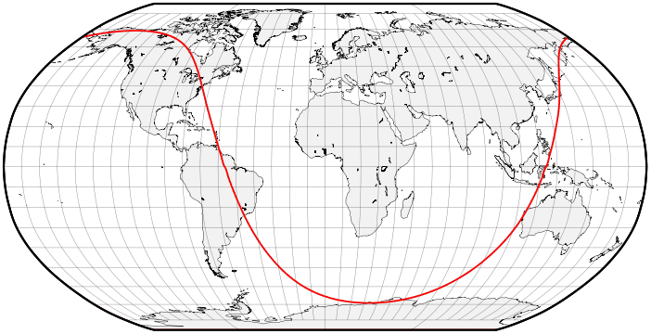
Great Circles Vs Rhumb Lines
https://beta.observablehq.com/@jake-low/satellite-ground-track-visualizer

Slide 42
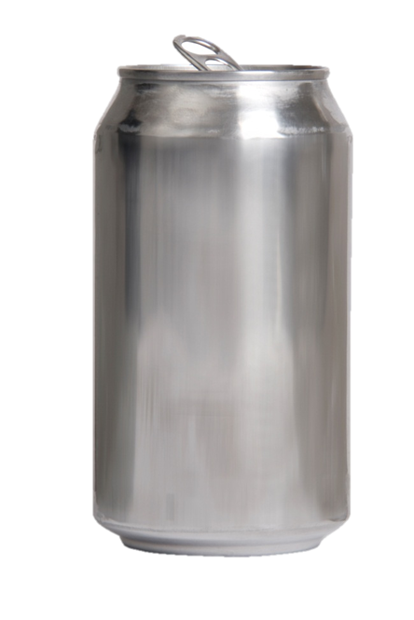
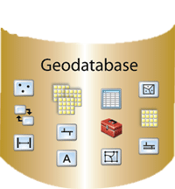
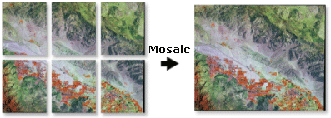
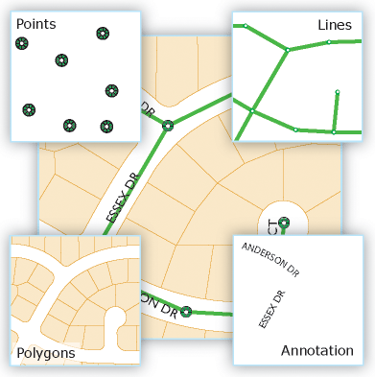
The Geodatabase
What is a Geodatabase?

Slide 43
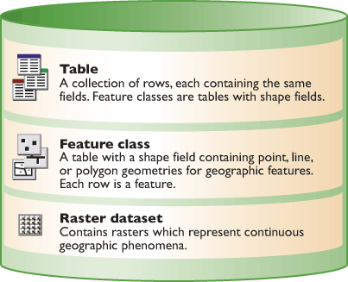
The Geodatabase
The geodatabase is the basic building block and storage vessel for all data management in GIS.
Many agencies still store layers as shapfiles, but they are missing the power and convenience of the GDB

Slide 44
The Geodatabase
The power of a GDB lies in the file hierarchy and the ability to normalize the layers in a single projection:
Feature Dataset (set projection that all imported layers inherit)
Feature Class (exp. Gauging Stations points)
Feature Class (exp. River lines)
Feature Class (exp. Lakes polygons)
Feature Datasets also allow you to set up Topologies
A Topology is a rule that governs interactions between layers
For Example, you could say that adjacent layers can’t have gaps.

Slide 45
Staying Organized
Remember:
Data come in many different formats
Data come in many different coordinate systems
Data come in many different projections
A Geodatabase is the best way to normalize the data:
But individual feature classes imported retain their reference system
So… you MUST use the Feature Dataset to normalize the coordinates
Always decide on a geographic coordinate system for the Feature Dataset
Then choose a projection from within the ArcGIS Pro Map Frame … ALWAYS!
EXCEPTION: Set the projection within the GDB only if you plan to use a
Geospatial Analysis tool that requires it (e.g., Geographically Weighted Regression)
Or… Your required to project in the GDB by an employer or professor
Rasters need to be normalized by using the Reproject Raster tool or creating a Mosaic Dataset, choosing the coordinate system, and importing rasters into it.

